Slide 1
Micro Air Vehicles (MAVs) - An Autonomous and Intelligent Scheduling System
Jose Tupayachi

Slide 2
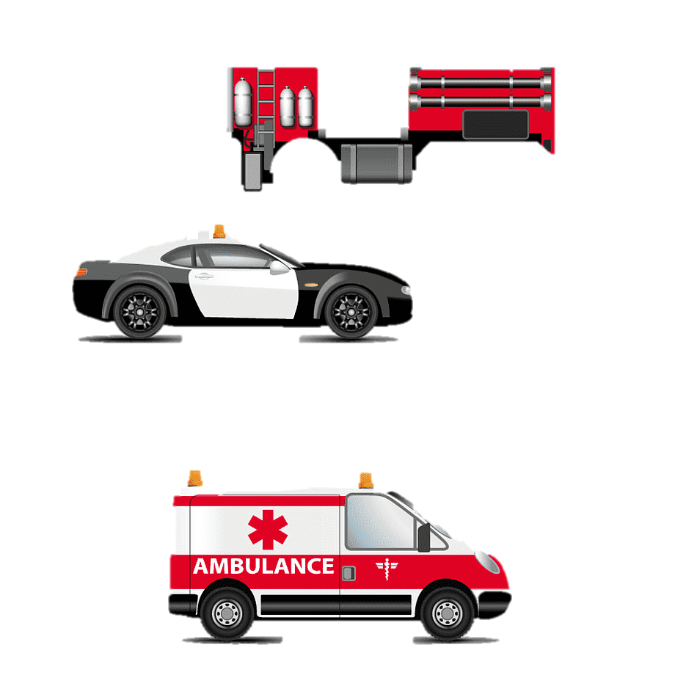
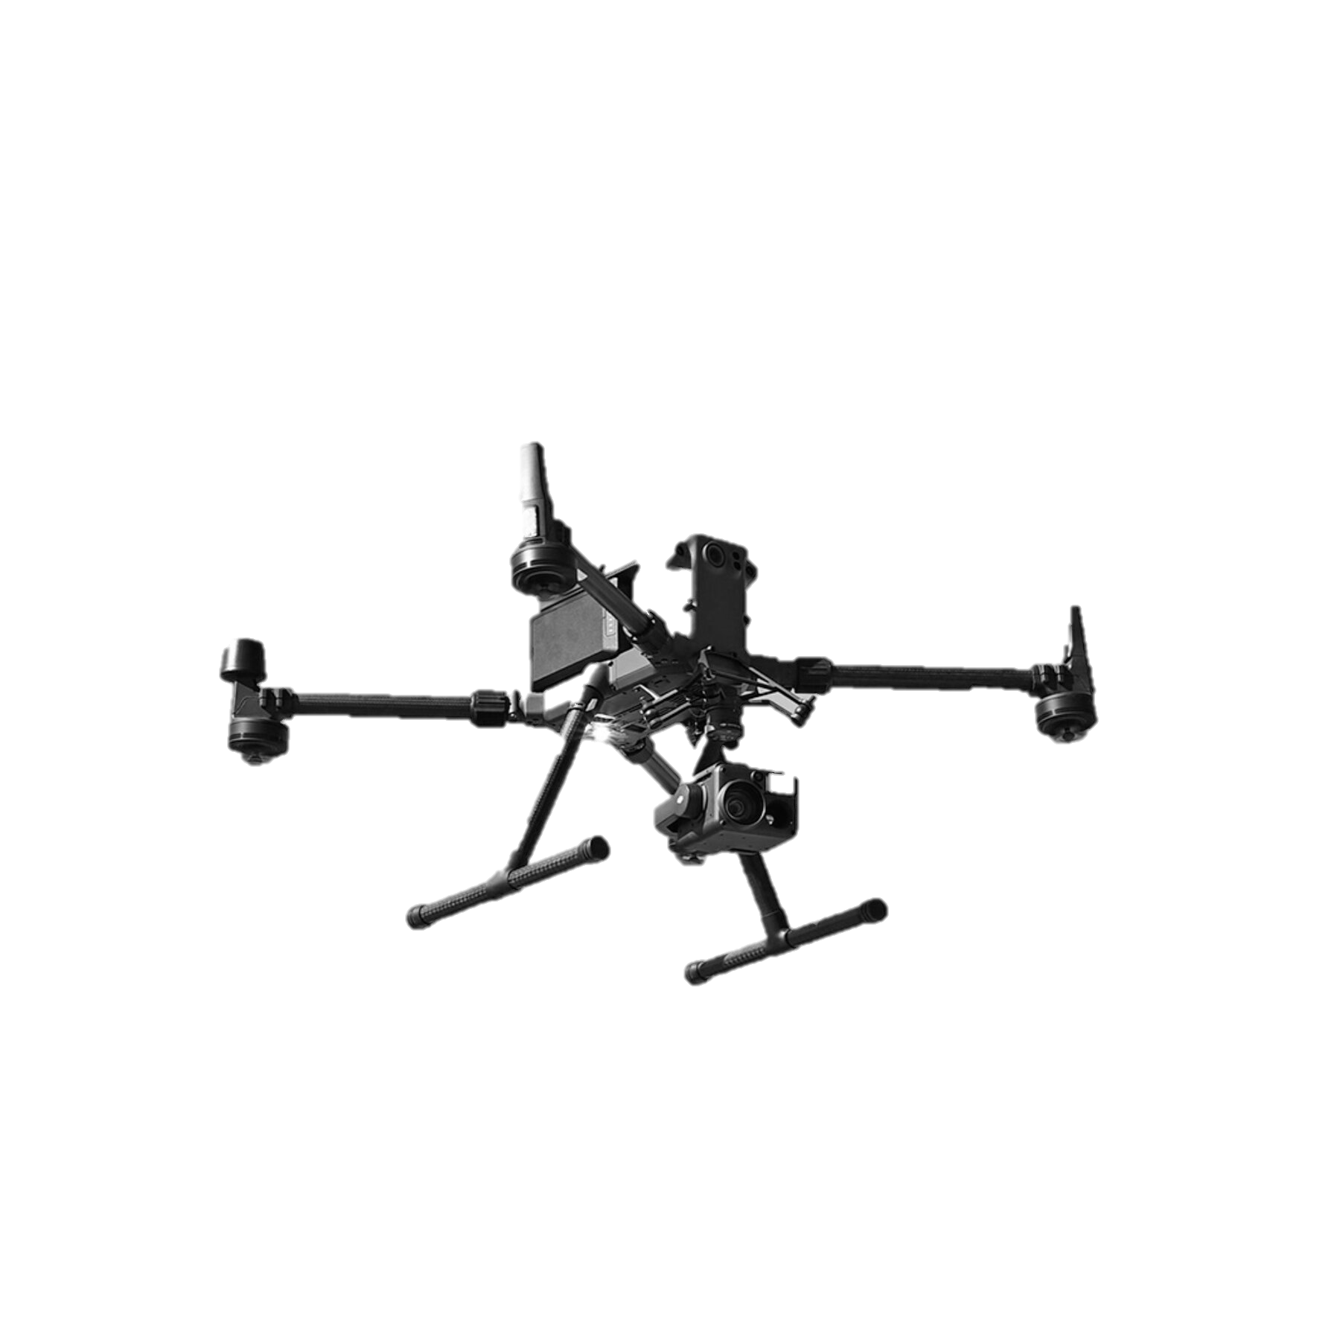
Keywords
Meta-heuristic
Patrolling
Genetic Algorithms
Traveling Salesman Problem
Discrete Simulation

Slide 3
Background and goals
Overview:
We propose a new technique to optimize Knoxville patrolling by employing Micro Aerial Vehicles (MAVs) to detect Activities of Interest (AOIs) in designated Points of Interest (POIs).
Aim:
Capitalize on the potential of lightweight micro-air vehicles (MAVs), outfitted with advanced high-resolution cameras to proactively detect and monitor activities of interest (AOIs) in a busy metropolitan area and perform route scheduling via mTSP and vehicle dispatch.
Motivation:
This novel technique answers the demand for effective metropolitan monitoring and vehicle dispatch.
How:
We build a collaborative system where MAVs work together to cover a bigger area effectively. We denote a mesh system to join work multiple agents in a Traveling Salesman Problem (mTSP)

Slide 4
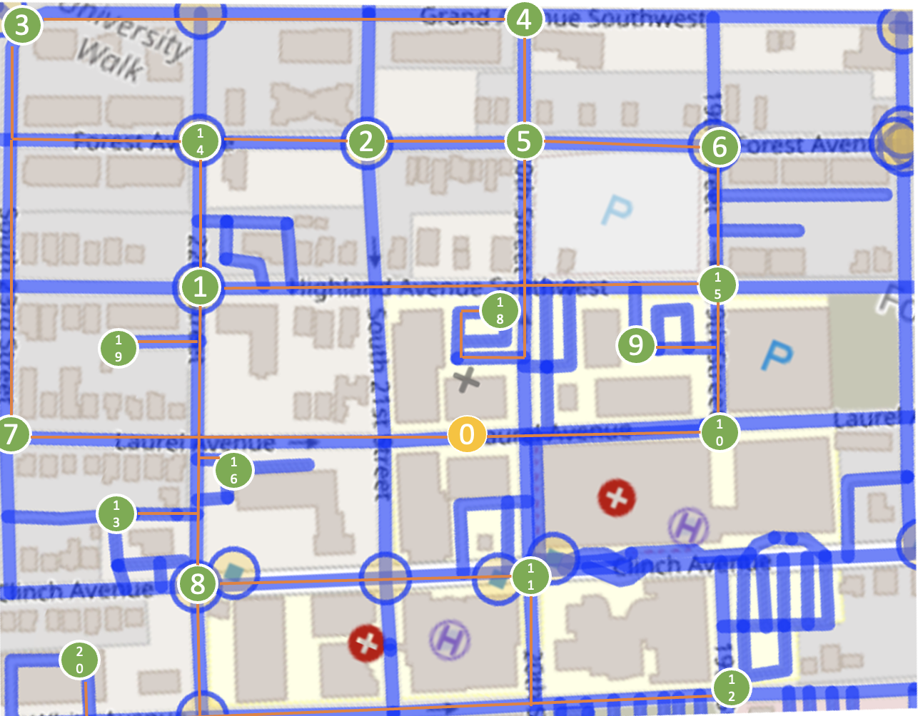
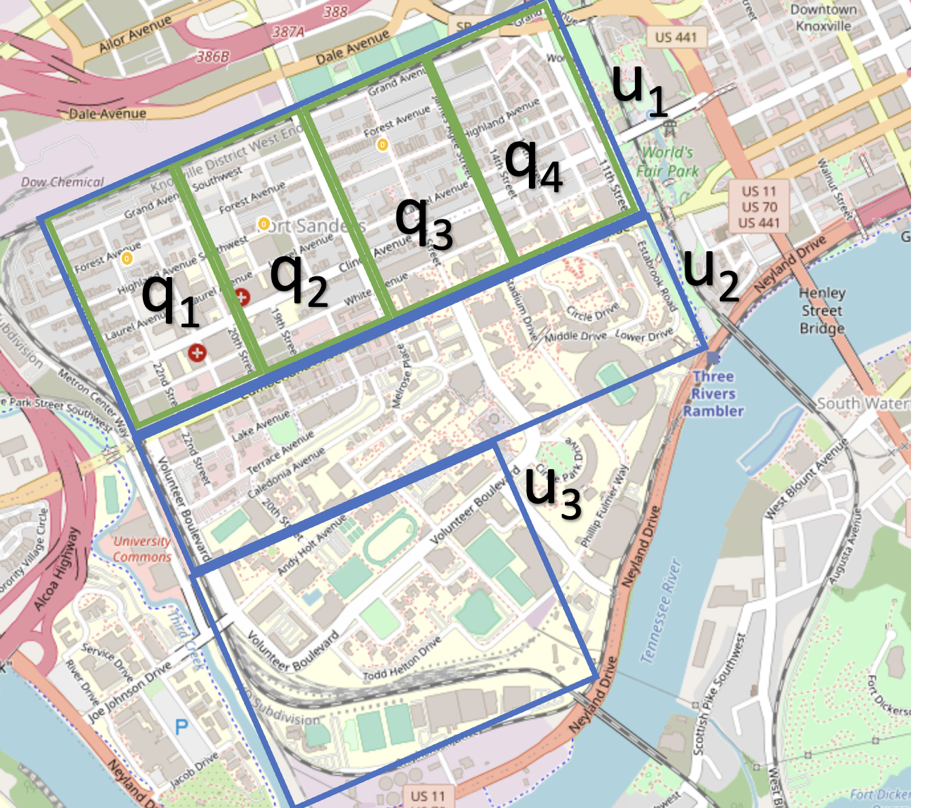
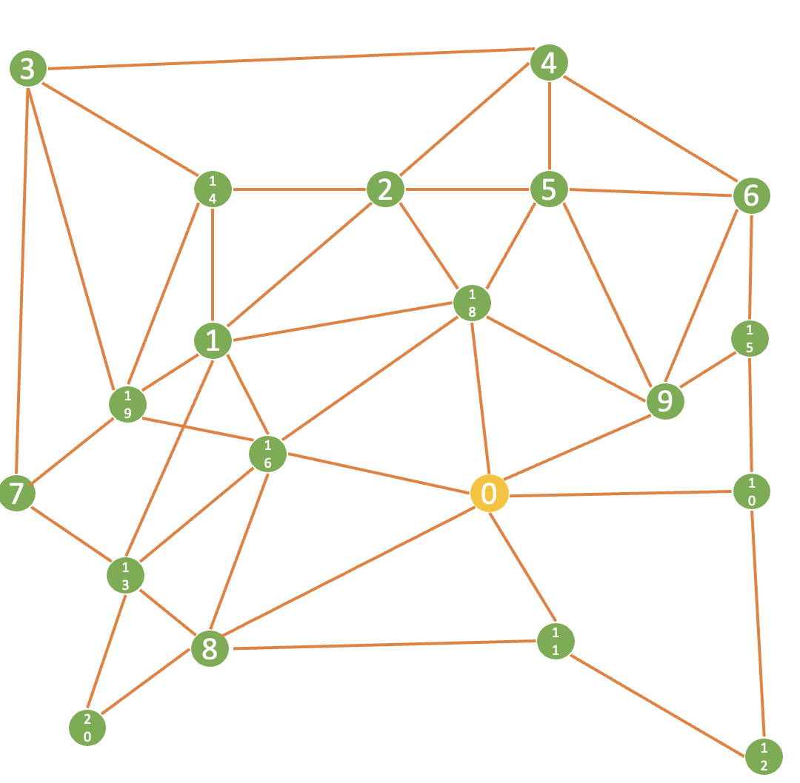
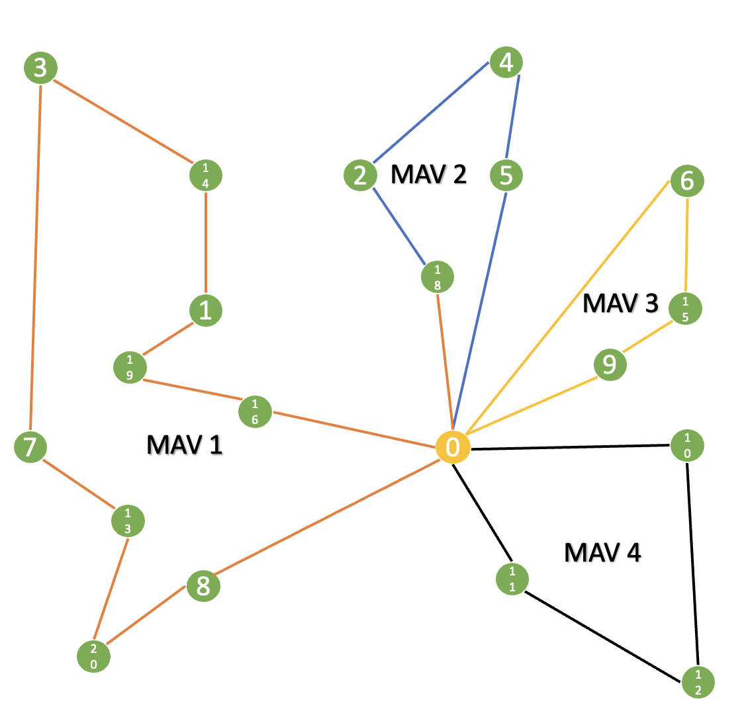
Novel Contribution
1
2
Propose and analyze the performance of the developed meta-heuristic technique for drone patrolling and emergency vehicle dispatch.
Analysis of a dispatch problem from the standpoint of discrete simulation and linear programming solved by the use of heuristic techniques (Genetic Algorithms).
3
POIs Extrapolation
Quadrant Separation
4
Heuristic Formulation

Slide 5
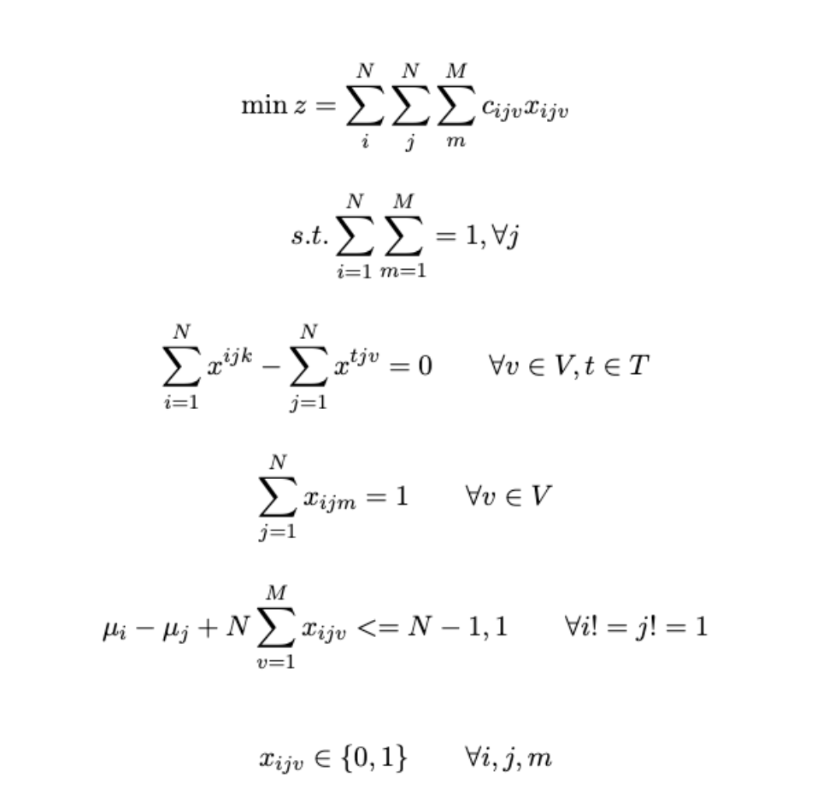
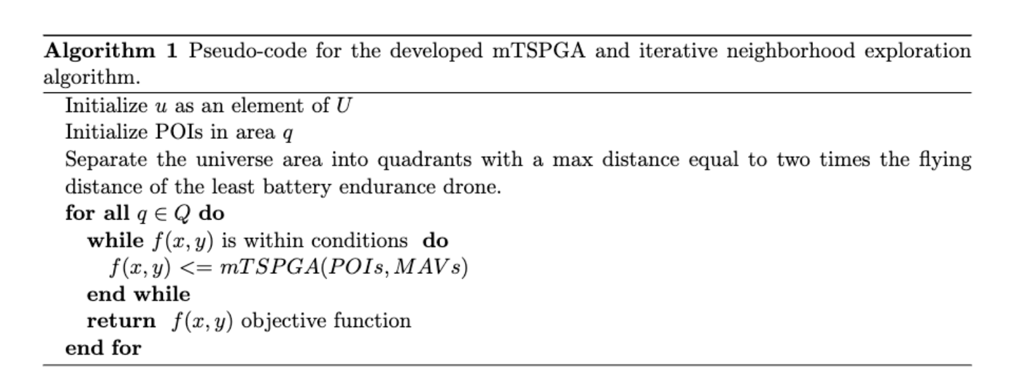
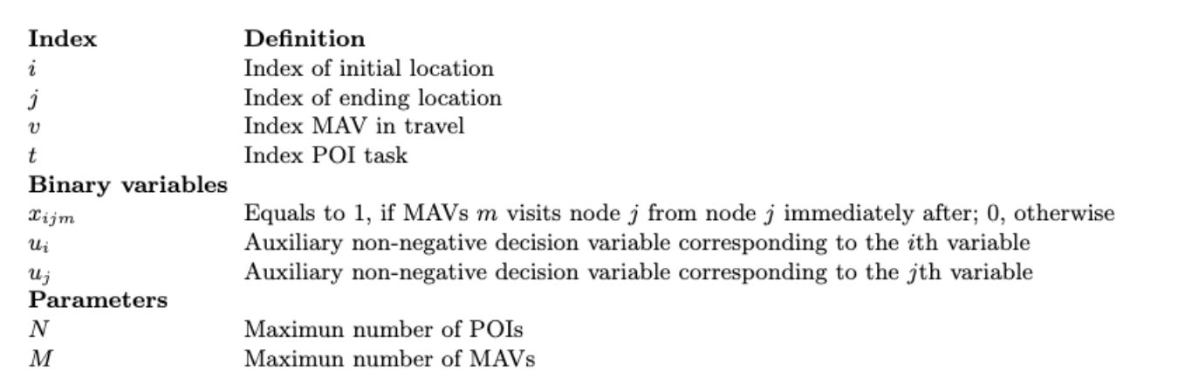
mTSP Formulation
Heuristic Formulation

Slide 6
Heuristic Formulation

Slide 7
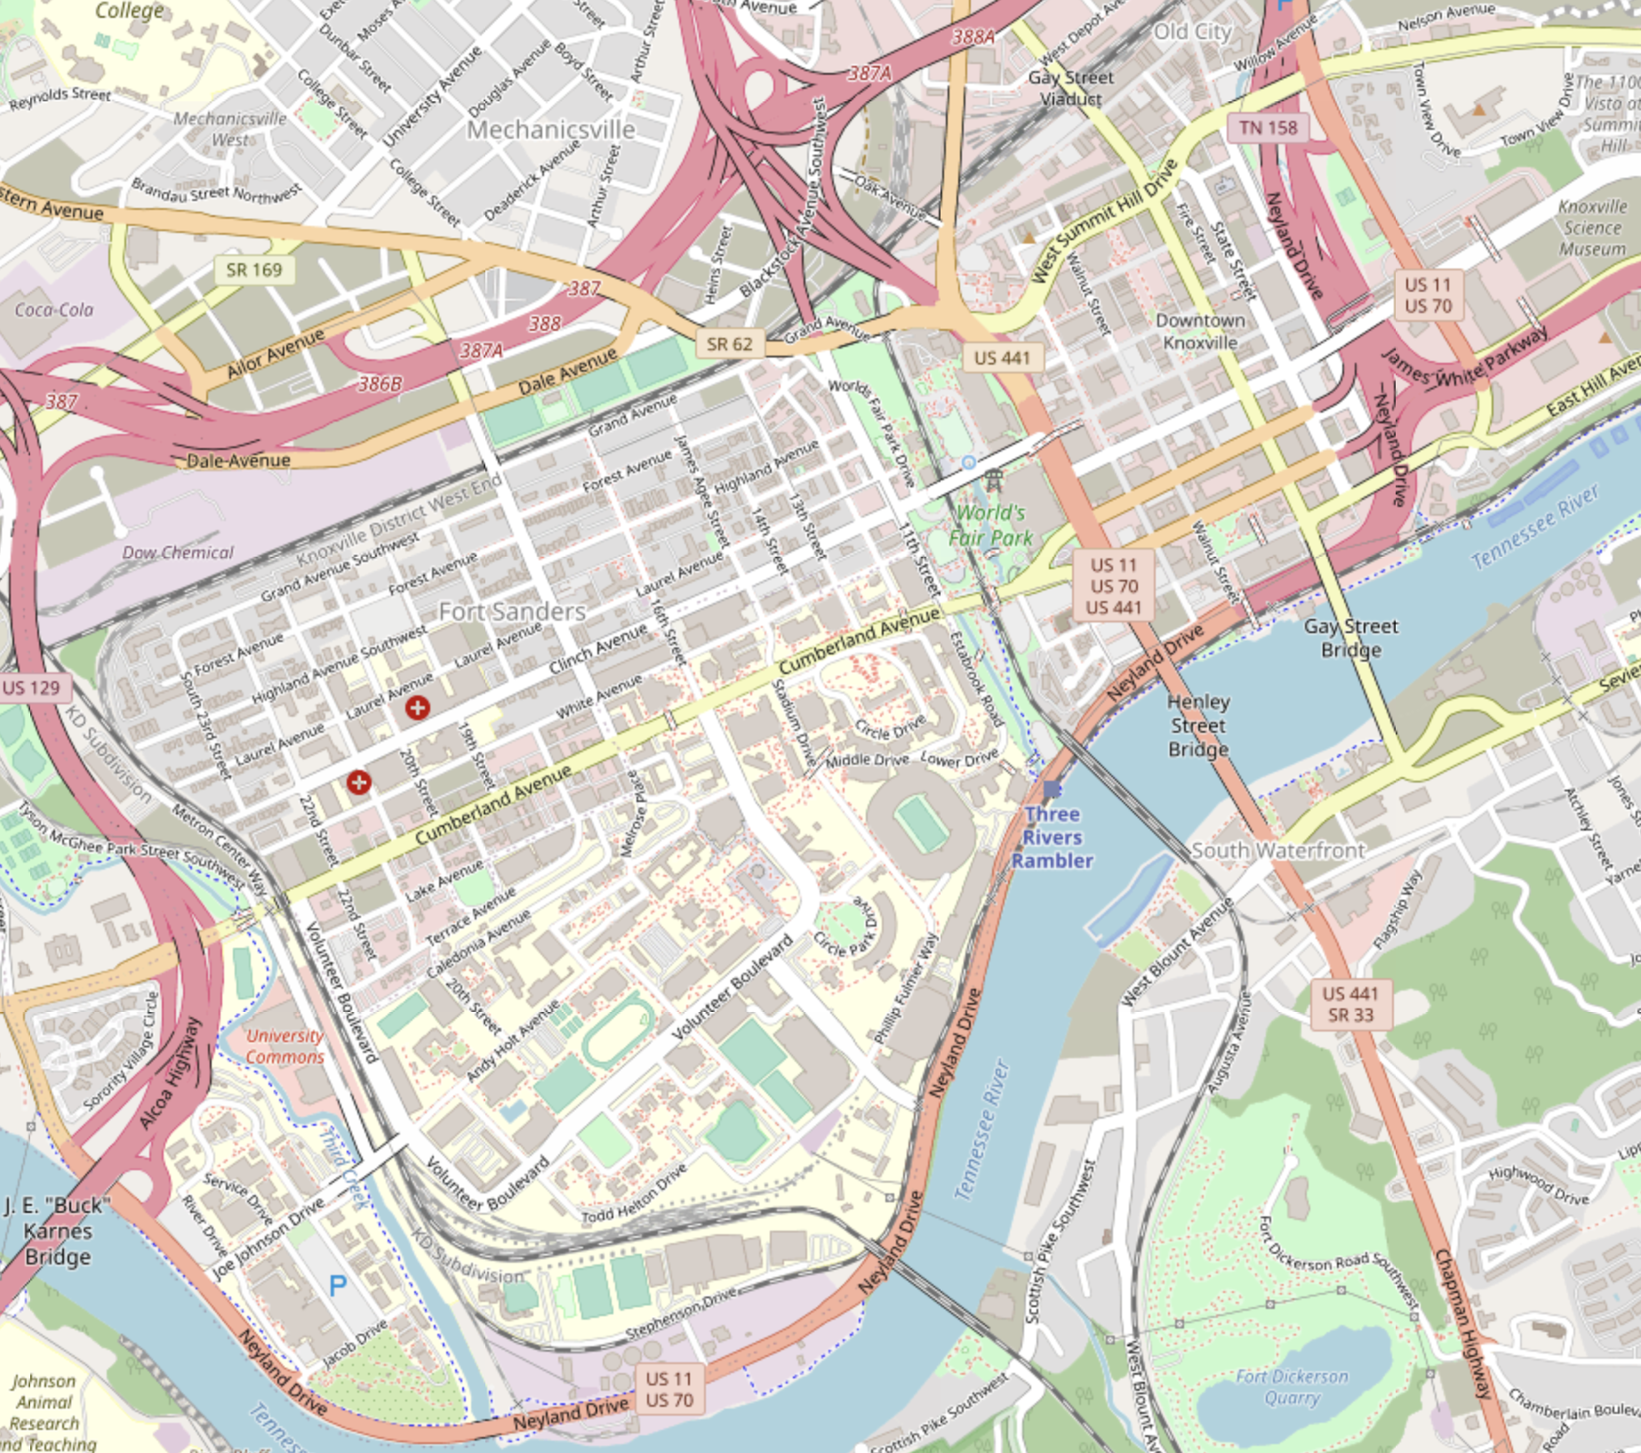
Quadrant Separation
u₁
q₄
0
q₃
q₂
u₂
q₁
0
0
u₃

Slide 8
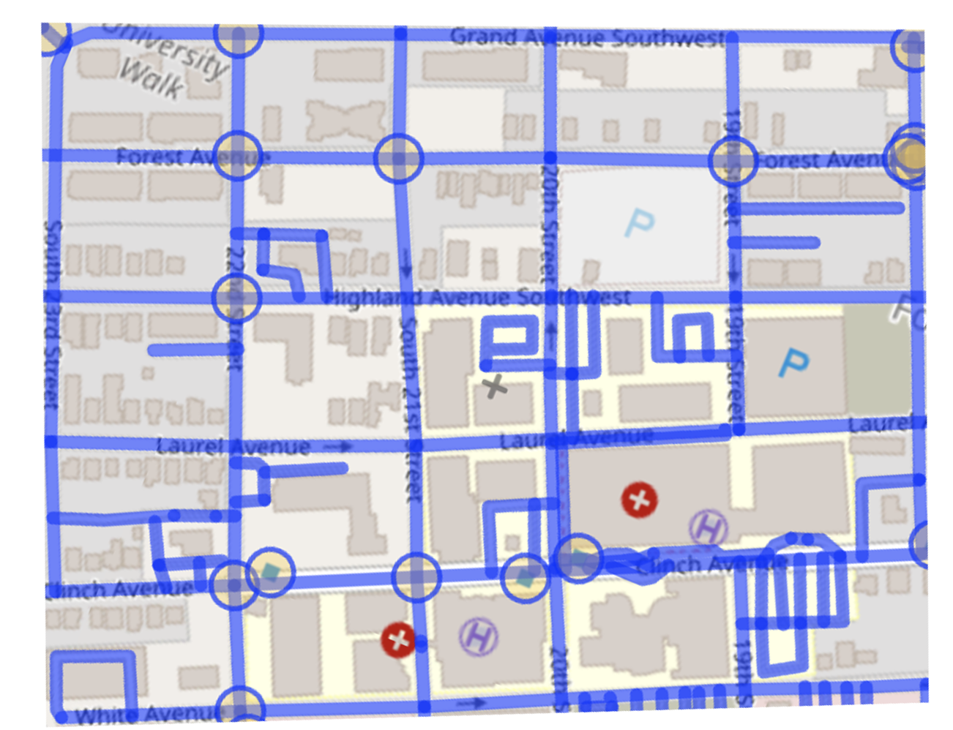
Quadrant Separation
3
4
14
2
5
6
1
15
18
19
9
7
0
10
16
13
8
11
20
12

Slide 9
POIs Extrapolation
4
3
14
2
5
6
18
1
15
19
9
16
7
0
10
13
8
11
20
12

Slide 10
Genetic Algorithms
3
4
14
2
MAV 2
5
6
18
1
MAV 3
15
19
9
16
7
MAV 1
0
10
13
MAV 4
8
11
20
12

Slide 12
u₁
q₄
0
q₃
q₂
u₂
q₁
0
0
u₃

Slide 13
Q1
3
4
14
2
5
6
1
15
18
19
9
7
0
10
16
13
8
11
20
12

Slide 14
Q1
3
4
14
2
5
6
18
1
15
19
9
16
7
0
10
13
8
11
20
12

Slide 15
Q1
3
4
14
2
MAV 2
5
6
18
1
MAV 3
15
19
9
16
7
MAV 1
0
10
13
MAV 4
8
11
20
12

Slide 16
u₁
q₄
0
q₃
q₂
u₂
q₁
0
0
u₃

Slide 17
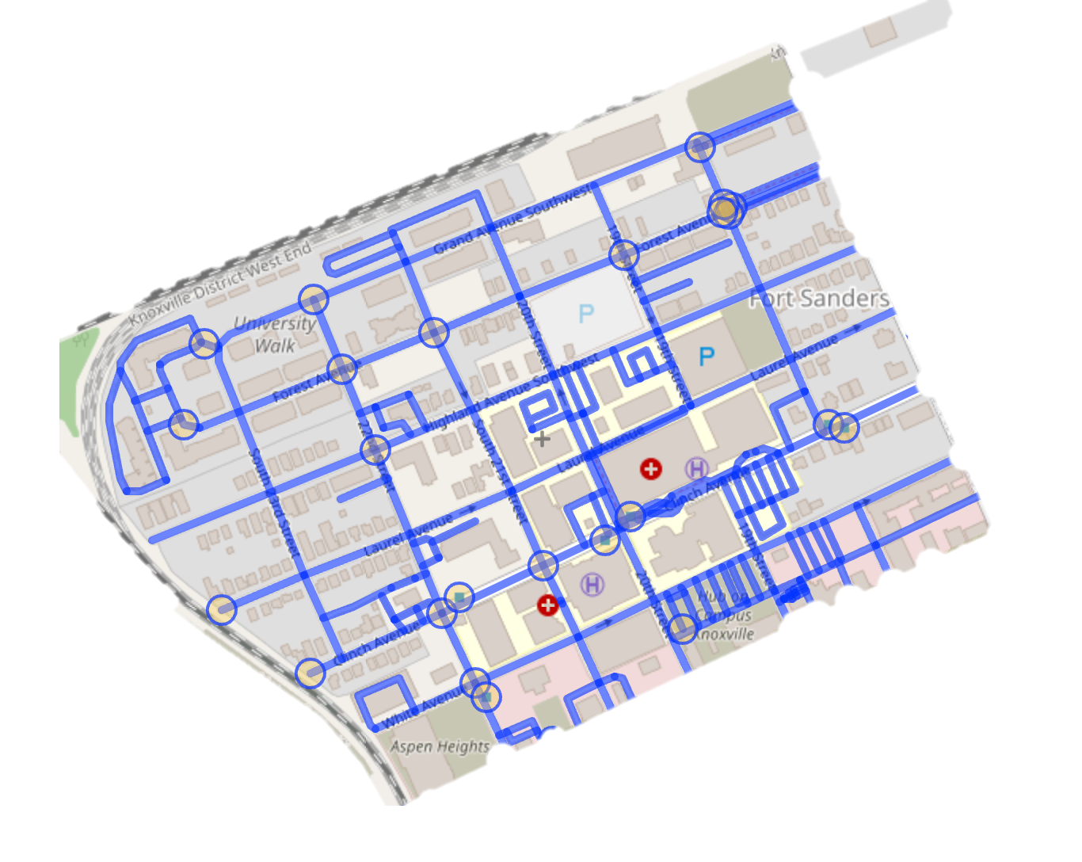

Slide 18
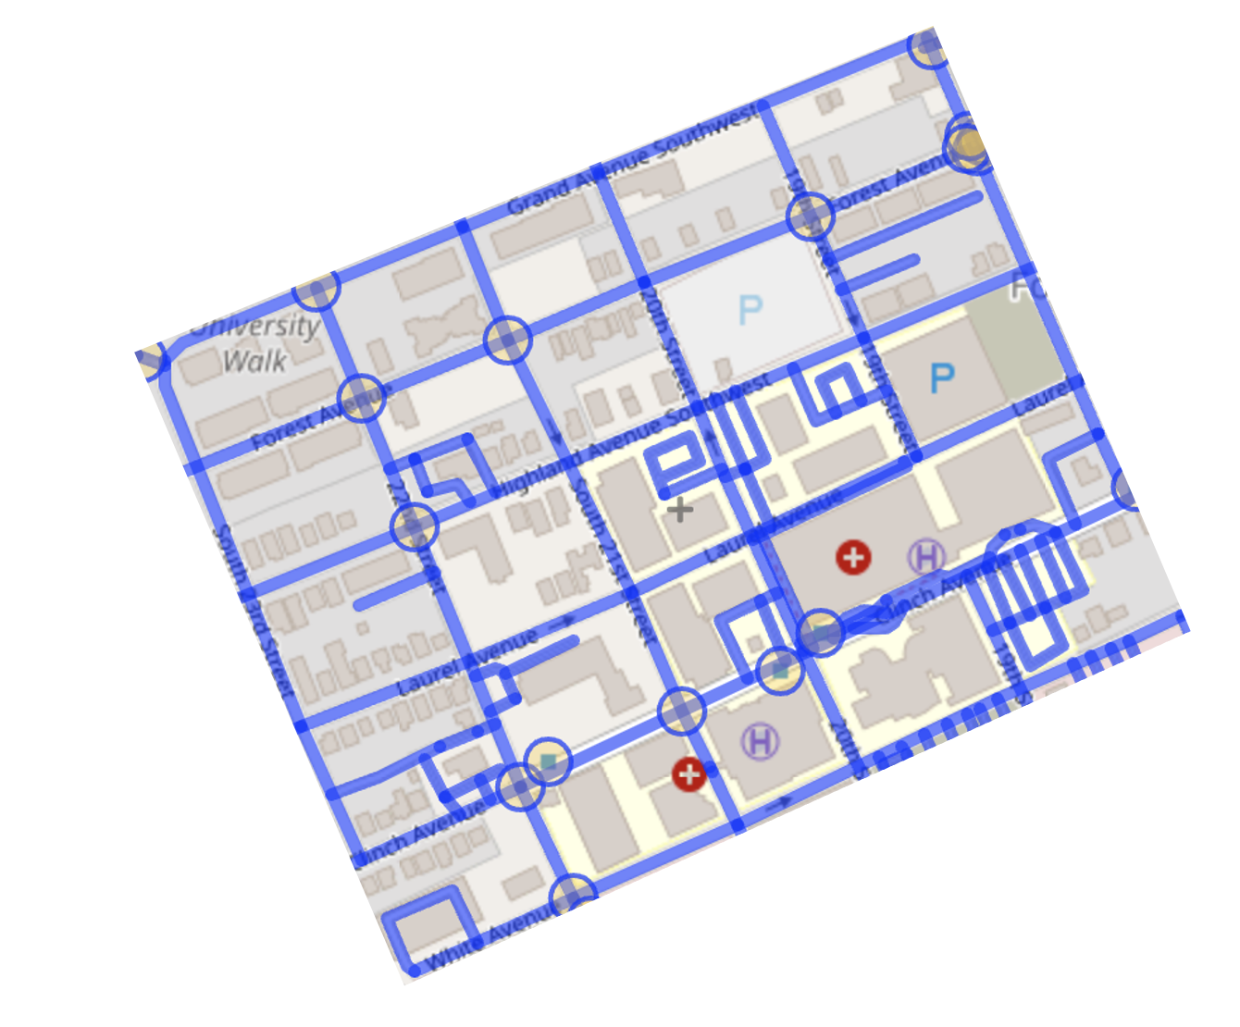

Slide 19
Q1
3
4
14
2
5
6
1
15
18
19
9
7
0
10
16
13
8
11
20
12

Slide 20
Q1
3
4
14
2
5
6
1
15
18
19
9
7
0
10
16
13
8
11
20
12

Slide 21
Q1
3
4
14
2
5
6
18
1
15
19
9
16
7
0
10
13
8
11
20
12

Slide 22
Q1
3
4
14
2
MAV 2
5
6
18
1
MAV 3
15
19
9
16
7
MAV 1
0
10
13
MAV 4
8
11
20
12

